Slide 1
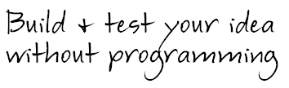
Get Going!
Build & test your idea without programming
Elizabeth Yin
Jennifer Chin
co-founders of LaunchBit

Slide 2





In high school, we decided to become internet entrepreneurs

Slide 3
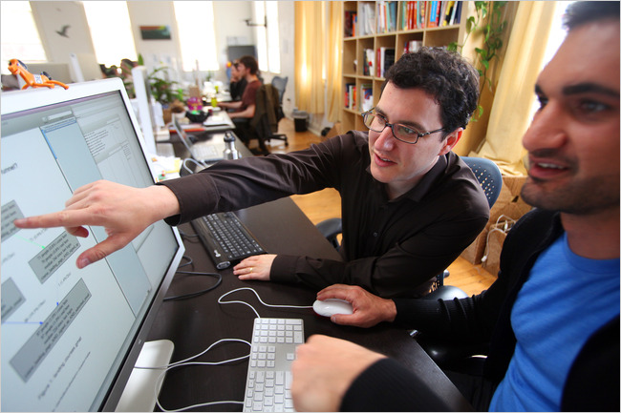
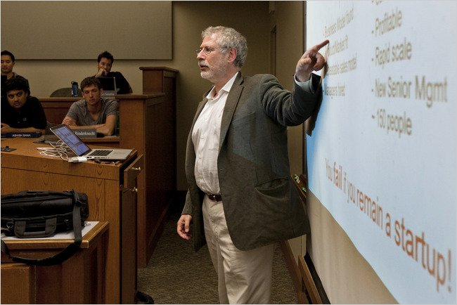
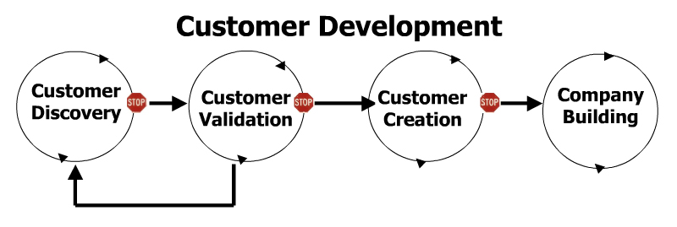
We believe in the “Lean Startup” philosophy and execution
Eric Reis (nytimes)
Steve Blank (nytimes)

Slide 4
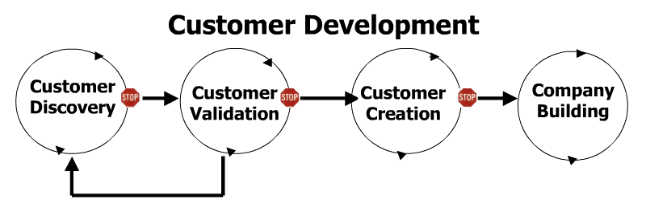
Most startups fail because they don’t find product/market fit
Maximize Profit
Product/Market Fit
Scale Up

Slide 5
Finding product/market fit needs both offline and online testing
Offline Testing
Online Testing
Customer
Interviews
Landing
Pages
Early
Prototypes
Product/Market Fit

Slide 6
Doing Customer Research

Slide 7






Talk to a range of customers… not your mom!
?
Notes:
Identify customer types

Slide 8





Post an ad on Craigslist to find local people willing to help you
http://www.craigslist.org
Cindy Alvarez
http://www.slideshare.net/cindyalvarez/user-testing-tactics
http://www.surveymonkey.com
http://docs.google.com

Slide 9
Start by asking questions to help you understand user behavior
What are the most frustrating aspects of ABC?
May I ask you why ABC is frustrating?
What is the process you go through today to do ABC?
If you had a magic wand to help you with ABC, what would it do?
How much would you expect this magic wand to cost?

Slide 10
In subsequent interviews, present your solution for feedback
So, you said ZYX of ABC was frustrating, what if the product looked like this?
Would you use it?
Do you have any friends whom you think could benefit from this?
How much would you expect this to cost, if anything?
We’d love to learn from your friend, mind making an intro?

Slide 11
Organize your answers and anecdotes into broad categories
maybe
no
might
not sure

Slide 12
Form teams and prepare customer interview questions (15 min)
Form teams and choose a web idea
Write customer interview questions
  What is most frustrating about ABC?
  May I ask you why ABC is frustrating?
  What process do you use to do ABC today?
  What would a magic wand for ABC do?
  How much would an ABC magic wand cost?

Slide 13
Don’t be shy! Interview someone on a different team (2 x 10 min)
Pair up with someone near you
Have one person interview the other for 10 minutes
Switch

Slide 14
Regroup and analyze what your group has learned (20 min)
Determine the scope/magnitude of the pain point
Identify the key attributes and differentiation points of your solution
Start to imagine your first prototype

Slide 15
Break

Slide 16
Case Study:
WedConnect

Slide 17
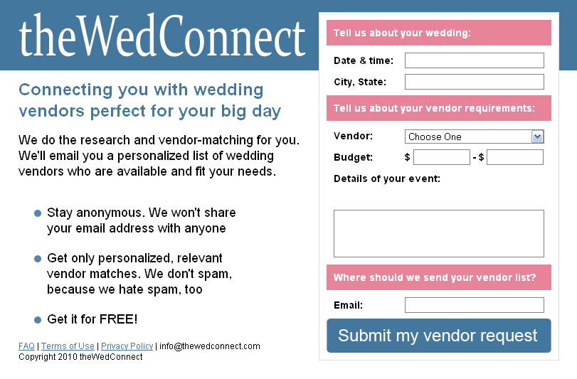
We had an idea to connect online brides to affordable vendors

Slide 18







3rd party tools can help you test a prototype quickly
Website Builders
“Behind the Curtain”
http://weebly.com
http://mail.google.com
http://unbounce.com
http://maps.google.com
Marketing Channels
http://www.mturk.com
http://adwords.google.com
http://answers.yahoo.com
http://docs.google.com

Slide 19

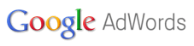
In 5 days, we had numbers to evaluate The Wed Connect
Bounce Rates
87% of 68 people
56% of 16 people
21 Signups*
Quick math:
  Charge wedding vendors $2 / lead * 21 leads = $42
  Costs: $0.44 * 68 people = $29.92
  Potential profit: $0.58 / person
* It doesn’t have to be statistically significant!

Slide 20

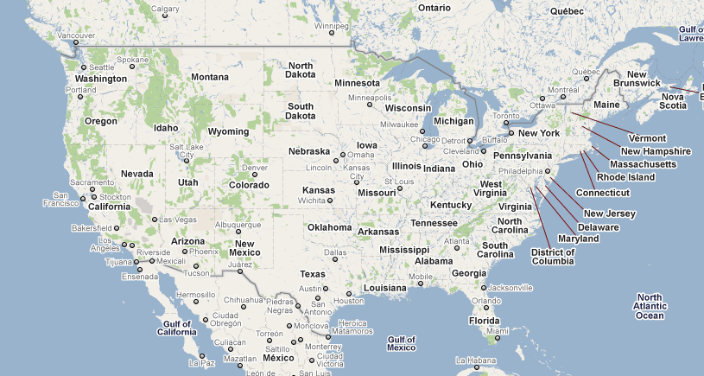


Qualitative feedback taught us about the customer
?
Great initial numbers but a frustrating business

Slide 21
Building Your Prototype

Slide 22
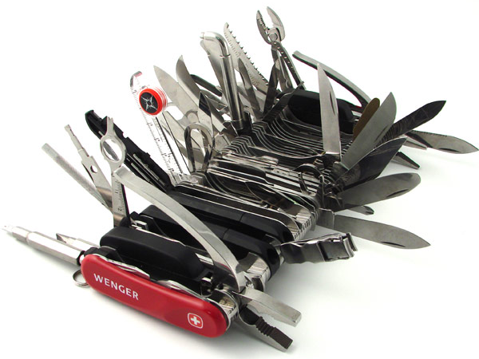
Think creatively in order to build your first prototype
Image Credit: Hammacher Schlemmer
Can you explain your product in 1 sentence?

Slide 23
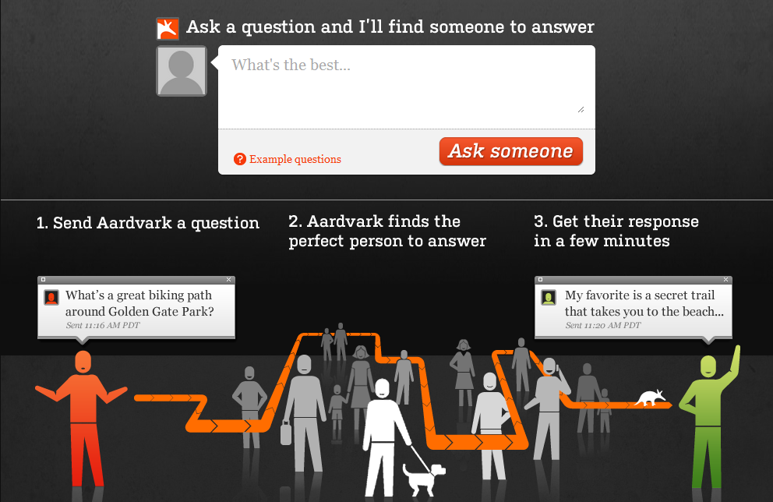


Aardvark went off to see the wonderful Wizard of Oz
http://google.com/talk
http://meebo.com
Notes:
Gtalk, meebo

Slide 24
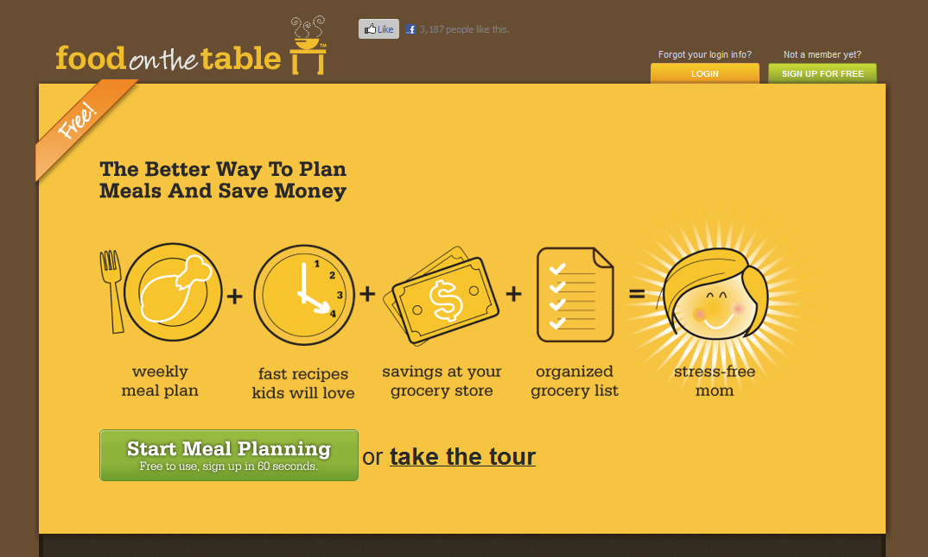


Food on the Table started with real, live “concierge” service
Pencil/Paper
Coffee shops
Notes:
Pencil/paper

Slide 25
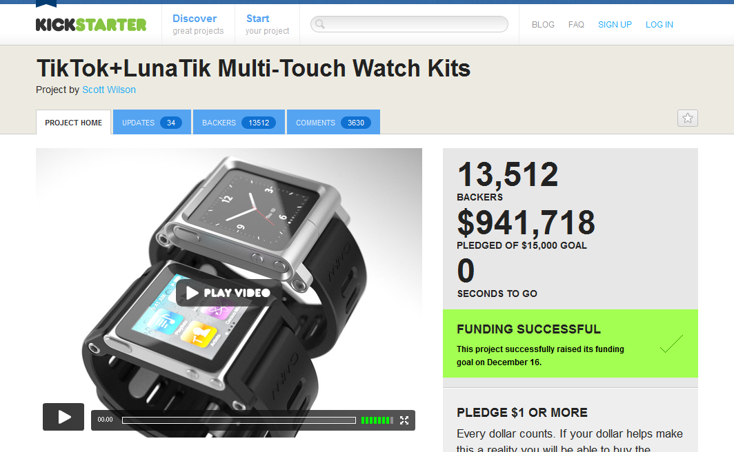


TikTok and LunaTik raised money for iPod nano watches
http://kickstarter.com
http://profounder.com
Notes:
Kickstarter, youtube, vimeo

Slide 26
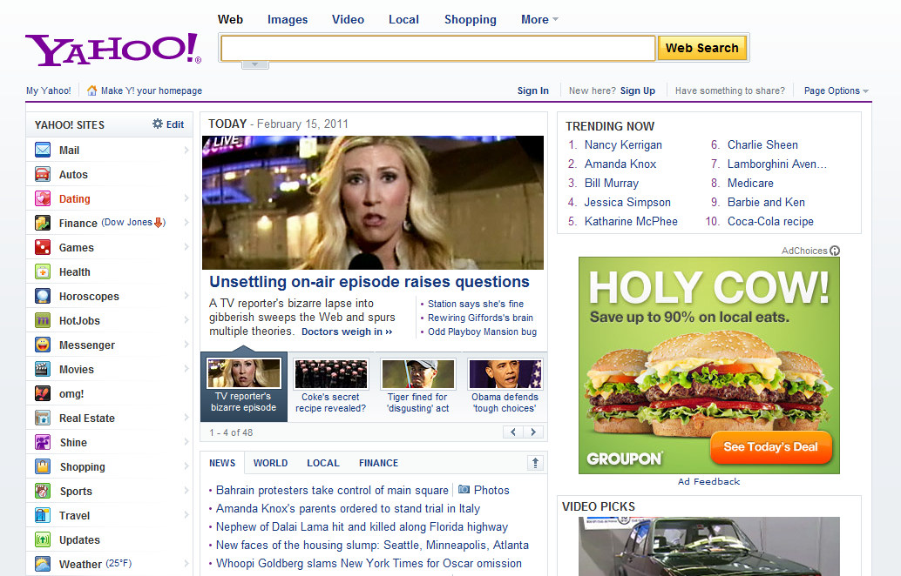

Yahoo! began as a manually curated collection of links
http://weebly.com
http://yola.com
Notes:
Weebly, yola

Slide 27
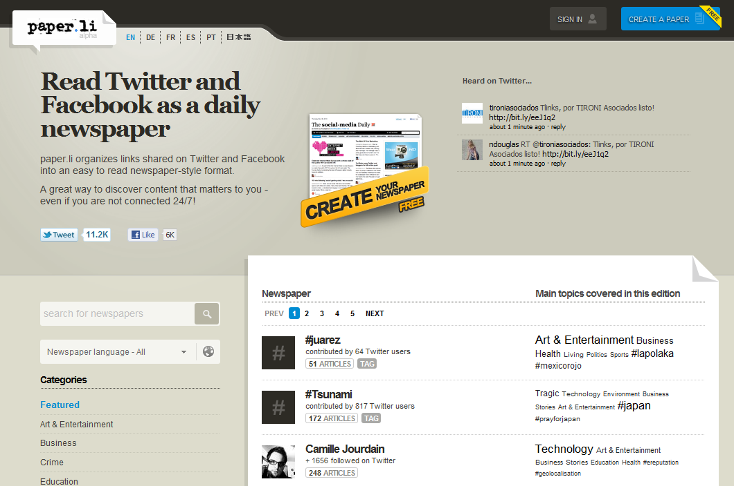


What if you wanted to build a newspaper from social media?
http://twitter.com
http://mturk.com
http://wordpress.com
Notes:
Twitter, mechanical turk, wordpress

Slide 28
Brainstorm a strategy for building your prototype (20 min)
Based on your interviews, what is the 1 key feature?
What tools can you use to build it?
(Optional) What marketing channels would you pursue?

Slide 29
Let’s hear some ideas! Share how to execute your idea (3 min each)
In 1-2 sentences, describe your customer’s pain
Describe how your idea solves it
What tools will you use to build your first prototype?

Slide 30


LaunchBit helps new entrepreneurs launch their web businesses
http://classroom.launchbit.com
Next class starts April 11
10% off with code W2E, expires April 1
http://guide.launchbit.com

Slide 31

Build and test your idea without programming – Get going!
Got questions? hello@launchbit.com
Feedback index cards
Mailing list: signup@launchbit.com
Blog: blog.launchbit.com
@launchbit
www.launchbit.com

